Slide 1
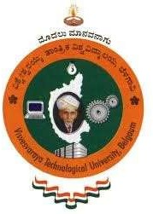

Shree devi institute of technology
DEPARTMENT OF ELECTRONICS AND COMMUNICATION ENGINEERING
“MULTIMODAL MEDICAL IMAGING FOR THE DETECTION
AND ANALYSIS OF BRAIN TUMORS”
Under the Guidance of
Mrs. Nischitha
Assistant Professor,
Dept. of ECE
Amrutha K M - 4SH21EC001
Gangotri H S - 4SH21EC003
Sucheta Krishna Naik - 4SH21EC011

Slide 2
TABLE OF CONTENTS
Introduction
Literature Review
Objectives
Methodology
Performance Metrics
Implementation Results
Statistical Analysis
Conclusion
Application
Future Scope
Reference

Slide 3
INTRODUCTION
Image fusion is the process of combining multiple images into a single image to enhance information and improve quality.
Multimodal imaging (MMI) is the use of two or more different imaging techniques(CT, MRI, PET etc.) in the same examination to gather more comprehensive information about a patient.
Image fusion enhances the image quality by combining complementary information from multiple sources for better analysis and interpretation.
Meningioma is a usually benign tumor that forms in the meninges, the protective layers surrounding the brain and spinal cord.
Glioblastoma is an aggressive and fast-growing Malignant brain tumor that originates from glial cells.

Slide 4
LITERATURE REVIEW
Paper | Year | Summary
"CT and MRI Medical Image Fusion Using Discrete Wavelet Transform" by Molham Moshantat, Saeid Karamzadeh | 2019 | Discusses the use of Discrete Wavelet Transform (DWT) for fusing CT and MRI images. The fusion enhances diagnostic accuracy by combining structural data from CT with detailed tissue information from MRI, using wavelet functions to improve image quality metrics like PSNR and entropy.
"A Robust and Secured Fusion-Based Hybrid Medical Image Watermarking Approach Using RDWT-DWT-MSVD with Hyperchaotic System-Fibonacci Q Matrix Encryption" by M. Sajeer, Ashutosh Mishra | 2023 | Focuses on medical image watermarking using hybrid techniques involving RDWT, DWT, and MSVD, along with Hyperchaotic systems and Fibonacci Q Matrix encryption. Aims to enhance the reliability of brain tumor detection by integrating advanced fusion algorithms for secure and accurate medical image analysis.
"A REVIEW: IMAGE FUSION USING DCT AND DWT" by Jaskeerat Kaur, Sandhya, Priyanka Ganjoo, Musheer Vaqur, Kapil Joshi | 2019 | Reviews the role of DWT and DCT techniques in image fusion, highlighting their ability to improve sharpness, accuracy, and information content. Emphasizes their importance in medical imaging for high-quality, multi-resolution images used in analysis and real-world applications.

Slide 5
OBJECTIVES
To develop a MATLAB-based framework for fusing CT, MRI, and PET images using both Discrete Wavelet Transform(DWT) and Multi-Resolution Singular Value Decomposition (MSVD).
To enhance image quality by integrating complementary structural, functional, and metabolic information.
To accurately align input images through image registration techniques for effective fusion.
To improve diagnostic accuracy for Glioblastoma (GBM) and Meningioma, aiding clinical decision-making.

Slide 6
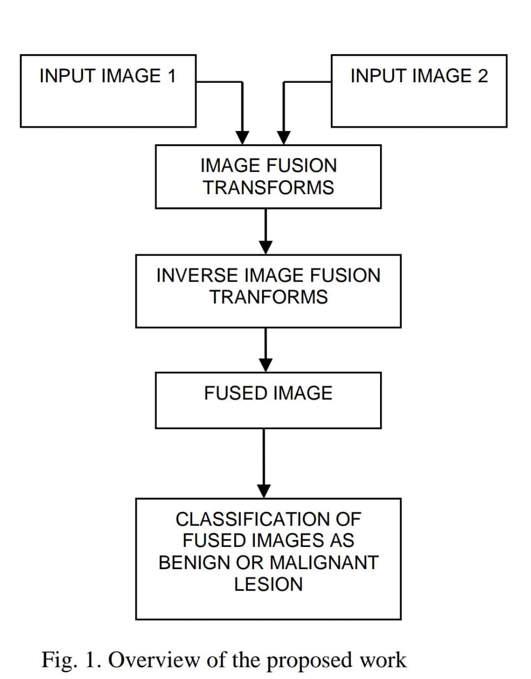
METHODOLOGY
FLOW CHART:
OVERVIEW OF PROPOSED WORK

Slide 7
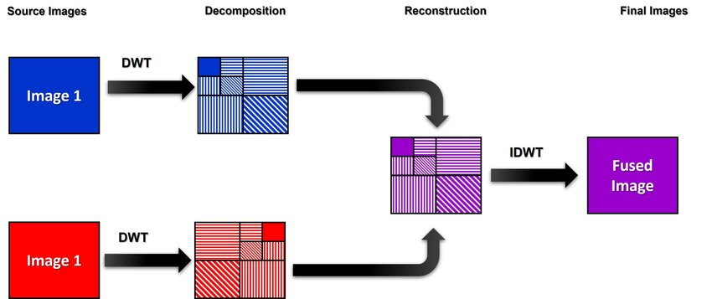
DISCRETE WAVELET TRANSFORM TECHNIQUES:
DWT (Discrete Wavelet Transform) is a signal processing technique that decomposes an images into multiple frequency sub - bands for
efficient analysis, compression, and fusion.

Slide 8
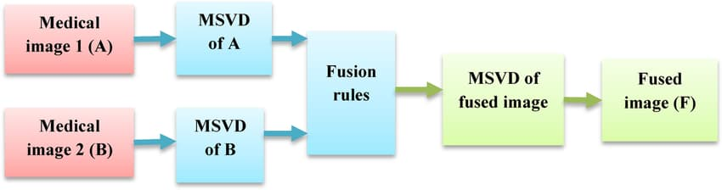
MSVD (Multi-Resolution Singular Value Decomposition) is an extension of Singular Value Decomposition (SVD) used in image processing to analyze and process images at multiple scales, improving feature extraction and fusion.
MULTI-RESOLUTION SINGULAR VALUE DECOMPOSITION (MSVD):

Slide 9
PERFORMANCE METRICES
Mean
Entropy
Standard Deviation
Mutual Information (Ma and Mb)
Fusion Factor (FF)

Slide 10
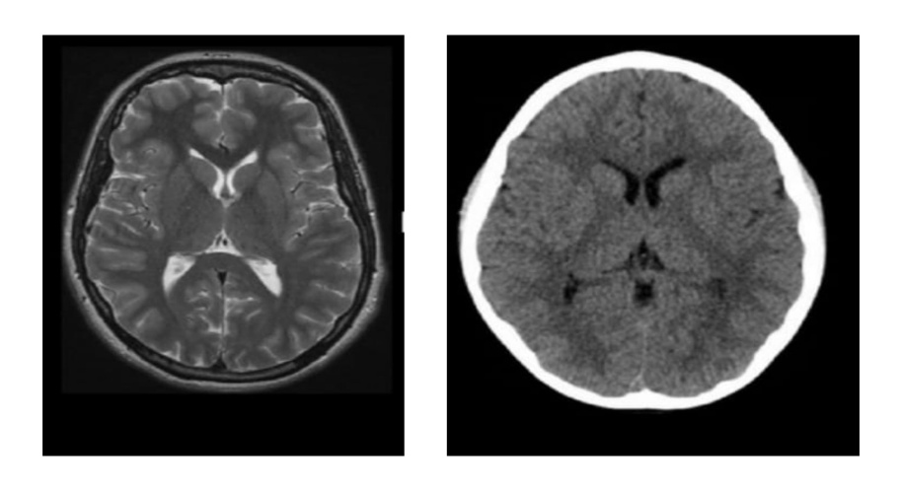
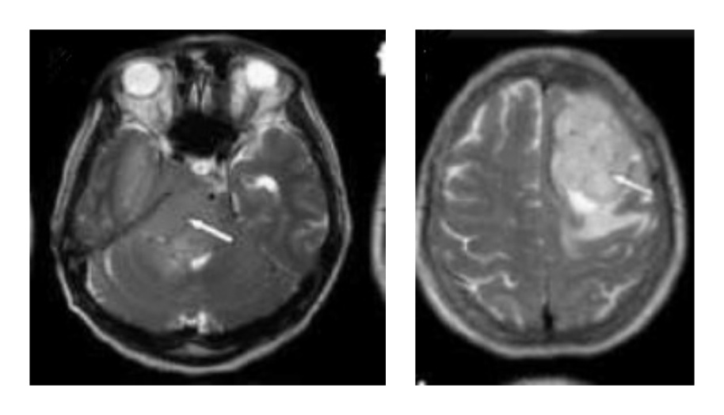
IMPLEMENTATION AND RESULTS
Input Data Sets:
(a) (b)
Input data set 1: (a) MRI (b) CT of Glioblastoma
(a) (b)
Input data set 2: (a) MRI (b) CT of Meningioma

Slide 11
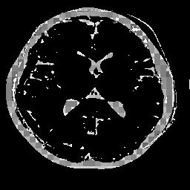
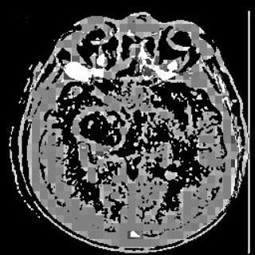
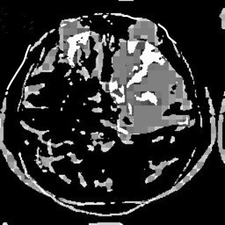
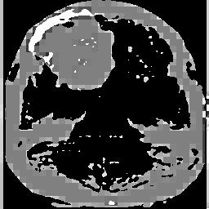
Fused Images of Glioblastoma and Meningioma using DWT and MSVD Techniques :
DWT fused image for input data set 1
MSVD fused image for input data set 1
DWT fused image for input data set 2
MSVD fused image for input data set 2

Slide 12

STATISTICAL ANALYSIS
Data set
Metrics
DWT
MSVD
16.9403
5.5907
5.5907
0.4190
0.3647
0.720
15.0901
5.0000
8.5608
0.5680
0.175
0.515
Mean
Entropy
Image Set 1
Glioblastoma
Standard Deviation
Ma
Mb
Fusion Factor
Mean
14.6858
6.0201
0.3637
0.1626
0.3544
0.8170
14.0001
5.9980
0.612
0.590
0.178
0.510
Image Set 2
Meningioma
Entropy
Standard Deviation
Ma
Mb
Fusion Factor

Slide 13
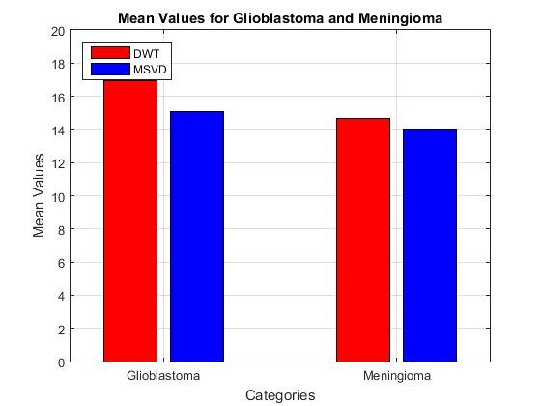
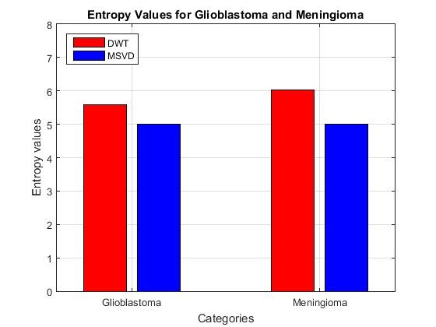
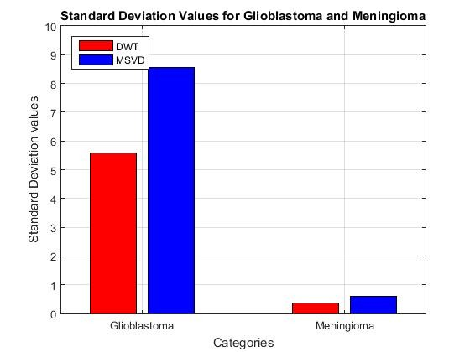
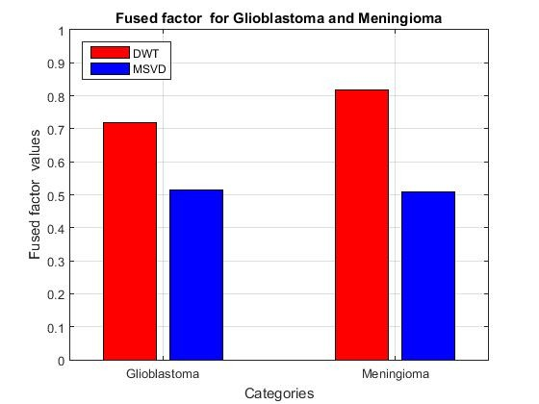
Plots for Various Performance Metrices:

Slide 14
CONCLUSION
Multimodal medical imaging combines medical scans like CT and MRI to enhance brain tumor detection and analysis.
Image fusion using DWT and MSVD successfully integrates CT and MRI data, producing a more accurate fused image.
Fusion enhances tumor visualization, improving image quality and aiding in better diagnosis and treatment planning.
Clearer imaging enables precise treatment, making multimodal imaging a vital tool for early detection and effective tumor management.

Slide 15
APPLICATIONS
Brain Tumor Diagnosis: Combines CT, MRI, PET, and SPECT for comprehensive insights and accurate detection of Glioblastoma and Meningioma.
Treatment Planning: Provides detailed images for precise plans and determining the most effective treatment approaches.
Research and Development: Facilitates studies on tumor behavior and supports the development of new imaging techniques.
Educational Purposes: Aids in medical education and training, enhancing the understanding of multimodal imaging and tumor diagnosis.

Slide 16
FUTURE SCOPE
Real-Time Processing:
Enable real-time image fusion for immediate diagnosis and decision-making.
Expanded Modalities:
Include additional imaging techniques like Ultrasound (US) and Optical Coherence Tomography (OCT).

Slide 17
REFERENCES
Molham Moshantat, Saeid Karamzadeh . "CT and MRI Medical Image Fusion Using Discrete Wavelet Transform,"published inJournal of Medical Imaging, Vol. 40-4 , pp. 939-945, 2019.
M. Sajeer & Ashutosh Mishra . "A Robust and Secured Fusion-Based Hybrid Medical Image Watermarking Approach Using RDWT-DWT-MSVD with Hyperchaotic System-Fibonacci Q Matrix Encryption,"published in Multimedia Tools and Applications, Vol. 82, pp. 37479–37501, 2023.
Jaskeerat Kaur, Sandhya, Priyanka Ganjoo, Musheer Vaqur, Kapil Joshi . "A Review: Image Fusion Using DCT and DWT," International Journal of Advanced Research in Computer Science and Software Engineering, Volume 10, Issue 2, ISSN 2229-5518, 2019.
Gerald K. Ijemaru, Augustine O. Nwajana, Emmanuel U. Oleka, Richard I. Otuka, Isibor K. Ihianle, Solomon H. Ebenuwa, Emenike Raymond Obi . "Image Processing System Using MATLAB-Based Analytics,"published in International Journal of Engineering and Technology, Vol. 10, No. 5, October 2021, pp. 2566-2577, 2021.

Slide 18
Gerald K. Ijemaru, Augustine O. Nwajana, Emmanuel U. Oleka, Richard I. Otuka, Isibor K. Ihianle, Solomon H. Ebenuwa, Emenike Raymond Obi . "Image Processing System Using MATLAB-Based Analytics," International Journal of Engineering and Technology, Vol. 10, No. 5, October 2021, pp. 2566-2577, 2021.
Xin Jin, Qian Jiang, Xing Chu, Xun Lang, Shaowen Yao, Keqin Li, Wei Zhou . "Brain Medical Image Fusion Using L2-Norm-Based Features and Fuzzy-Weighted Measurements in 2-D Littlewood–Paley EWT Domain," IEEE Access, Vol. 8, pp. 12345–12356, 2020.
Kedar Nath Singh, Om Prakash Singh, Amit Kumar Singh, Amrit Kumar Agrawal . "WatMIF: Multimodal Medical Image Fusion-Based Watermarking for Telehealth Applications," Journal of Medical Imaging and Health Informatics, Vol. 16, pp. 1947–1963, 2022.
Rui Zhu, Xiongfei Li, Xiaoli Zhang, Mingrui Ma . "MRI and CT Medical Image Fusion Based on Synchronized-Anisotropic Diffusion Model," IEEE Access, Vol. 8, Article 2993493, doi: 10.1109/ACCESS. 2020.2993493, 2020.

Slide 19
THANK YOU

